Slide 1
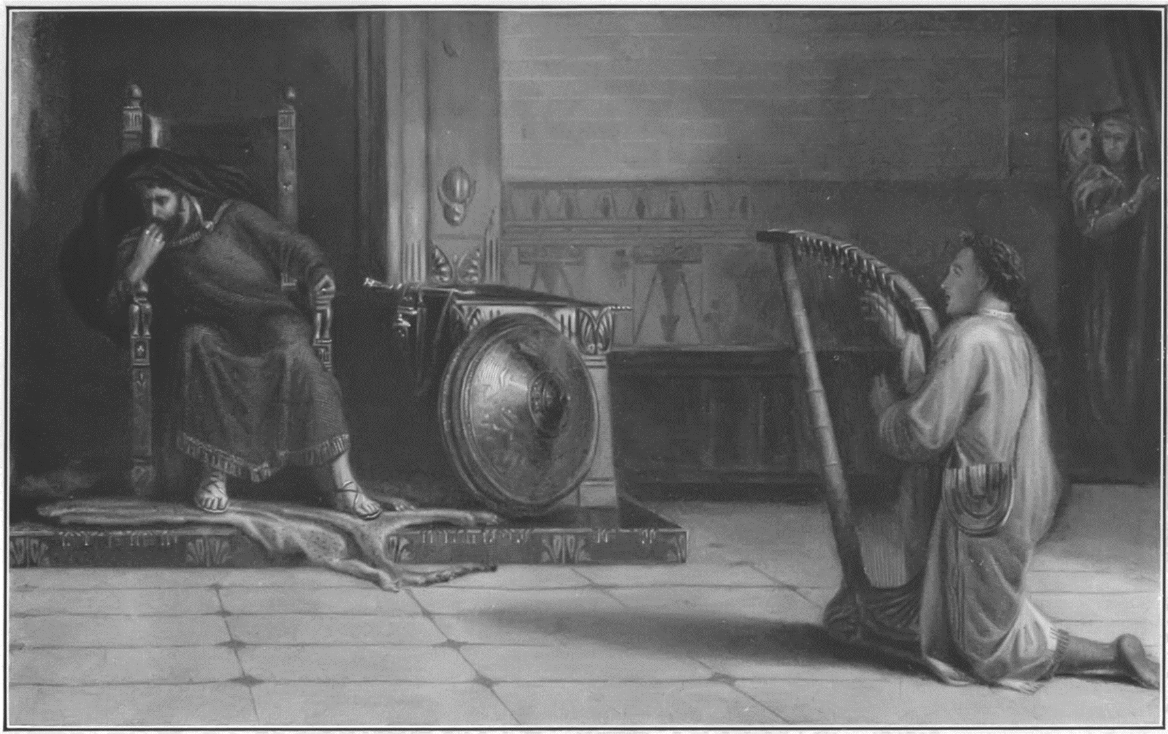
PERSECUTION
1 Samuel 18:12-30

Slide 2
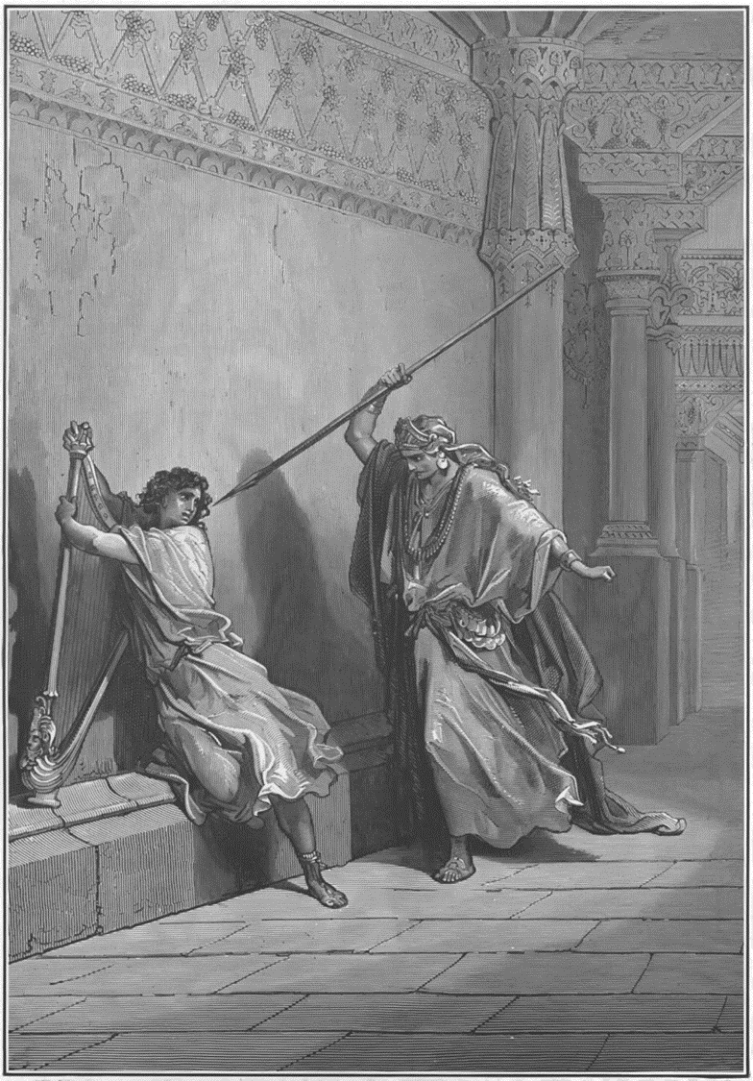
David’s Persecution.
Saul knows that David is his replacement.
Saul’s solution? Murder.
Psalm 37:32 The wicked watcheth the righteous, and seeketh to slay him.

Slide 3

David’s wisdom, Saul’s fear.
Envy makes you crazy!
Proverbs 14:30 A sound heart is the life of the flesh: but envy the rottenness of the bones.

Slide 4
Colossians 3:23 And whatsoever ye do, do it heartily, as to the Lord, and not unto men;

Slide 5
If the Lord is with you, you will behave yourself wisely!
When the Lord is with you…
You don’t just survive, you thrive! Ishmael Gen 21
Word gets out about it. Abraham Gen 21
You prosper. Jacob Gen 28; Joseph Gen 39
You become a leader. Moses and Joshua Josh 1; Samuel 1; 3
What about you?

Slide 6
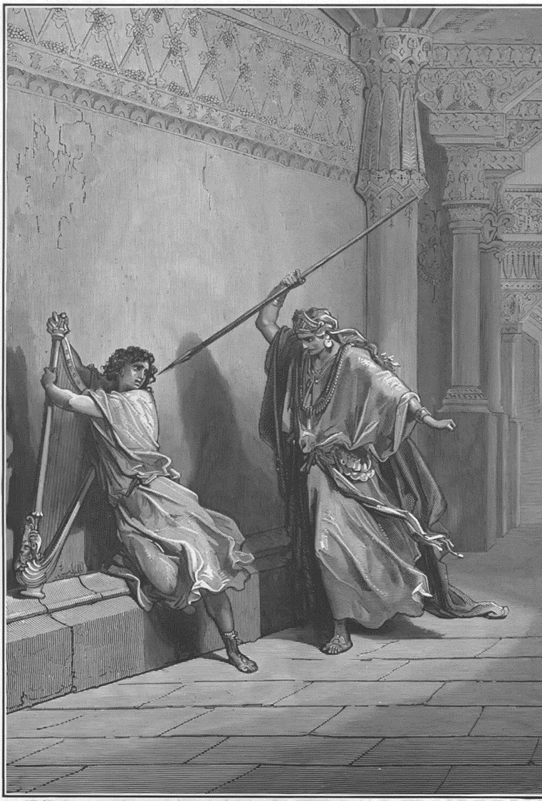
There will be those who despise the Lord and His Word that will be afraid of you.
Fear is why they attack.
2 Timothy 3:12 Yea, and all that will live godly in Christ Jesus shall suffer persecution.
Satan motivates attack.

Slide 7
Matthew 8:31-34 So the devils besought him, saying, If thou cast us out, suffer us to go away into the herd of swine. 32 And he said unto them, Go. And when they were come out, they went into the herd of swine: and, behold, the whole herd of swine ran violently down a steep place into the sea, and perished in the waters. 33 And they that kept them fled, and went their ways into the city, and told every thing, and what was befallen to the possessed of the devils. 34 And, behold, the whole city came out to meet Jesus: and when they saw him, they besought him that he would depart out of their coasts.

Slide 8
Matthew 25:41 Then shall he say also unto them on the left hand, Depart from me, ye cursed, into everlasting fire, prepared for the devil and his angels:

Slide 9
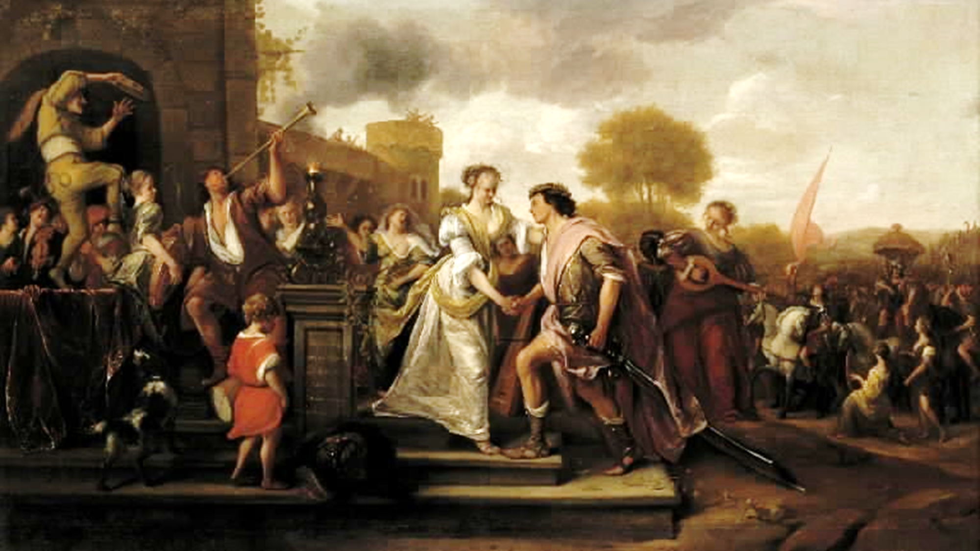
Be with people.

Slide 10
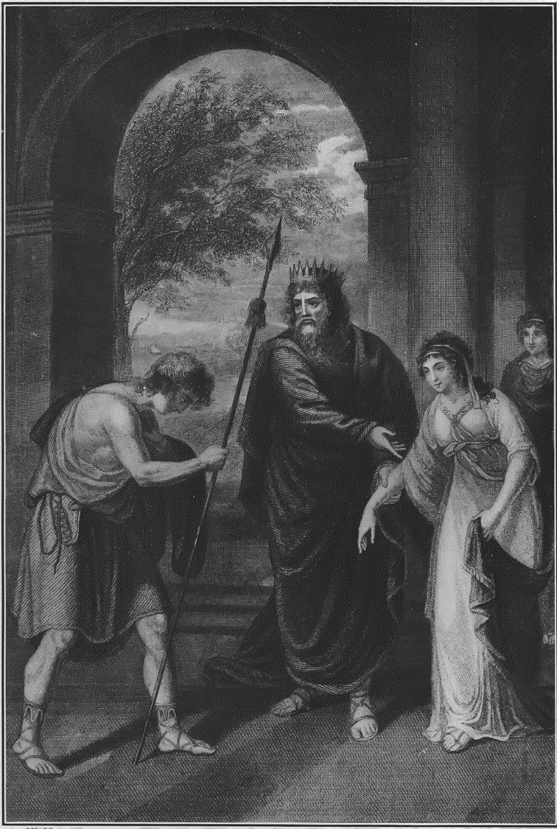
It’s a trap!
Merab was OWED David from chpt 17. David killed Goliath.
Saul is now adding stipulations.
Saul’s hope is for David to die in battle. Attempt number 3!
Before, Saul loved David! 16:21. Now Saul reeks of jealous hate.

Slide 11
It’s a trap!
When you live for God, you’ll face being cheated in this world.
Judges 14:20 But Samson's wife was given to his companion, whom he had used as his friend.
David was a man of faith. Saul was a man of deceit!

Slide 12
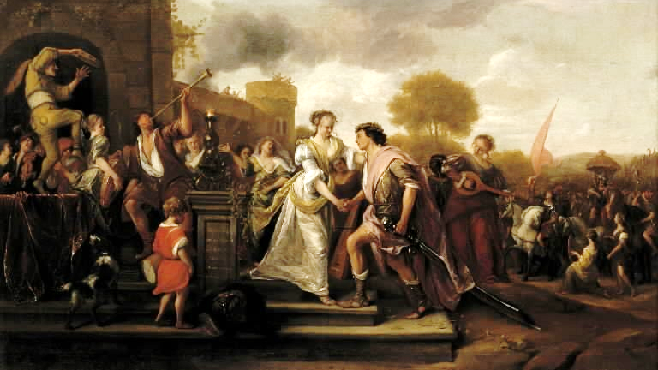

Slide 13

It’s a trap!
Be careful when wicked men want to promote you. It isn’t so that you will be blessed.

Slide 14
Proverbs 26:24-28 He that hateth dissembleth with his lips, and layeth up deceit within him; 25 When he speaketh fair, believe him not: for there are seven abominations in his heart. 26 Whose hatred is covered by deceit, his wickedness shall be shewed before the whole congregation. 27 Whoso diggeth a pit shall fall therein: and he that rolleth a stone, it will return upon him. 28 A lying tongue hateth those that are afflicted by it; and a flattering mouth worketh ruin.

Slide 15
Psalm 55:20-23 He hath put forth his hands against such as be at peace with him: he hath broken his covenant. 21 The words of his mouth were smoother than butter, but war was in his heart: his words were softer than oil, yet were they drawn swords. 22 Cast thy burden upon the LORD, and he shall sustain thee: he shall never suffer the righteous to be moved. 23 But thou, O God, shalt bring them down into the pit of destruction: bloody and deceitful men shall not live out half their days; but I will trust in thee.

Slide 17
What is the key to success?
That’s TWO of Saul’s children that LOVE David. They both protect him from their father!
Notice that David was NOT Saul’s enemy.
Epesians 6:10 Finally, my brethren, be strong in the Lord, and in the power of his might.
12 For we wrestle not against flesh and blood, but against principalities, against powers, against the rulers of the darkness of this world, against spiritual wickedness in high places.
What Saul meant for evil, God used for good. Rom 8:28-29

Slide 18
Ephesians 5:17-21 Wherefore be ye not unwise, but understanding what the will of the Lord is. 18 And be not drunk with wine, wherein is excess; but be filled with the Spirit; 19 Speaking to yourselves in psalms and hymns and spiritual songs, singing and making melody in your heart to the Lord; 20 Giving thanks always for all things unto God and the Father in the name of our Lord Jesus Christ; 21 Submitting yourselves one to another in the fear of God.

Slide 19
PERSECUTION
1 Samuel 18:12-30

